Slide 1
OpenETCS project Summary of WP3 priorities concerning traceability
Meeting of 25 September 2015 + complements
Prepared by Raphael Faudou
(Samares Engineering)

Slide 2
Key points summary
OpenETCS traceability process versus standard process
WP3 main priorites concerning traceability

Slide 3
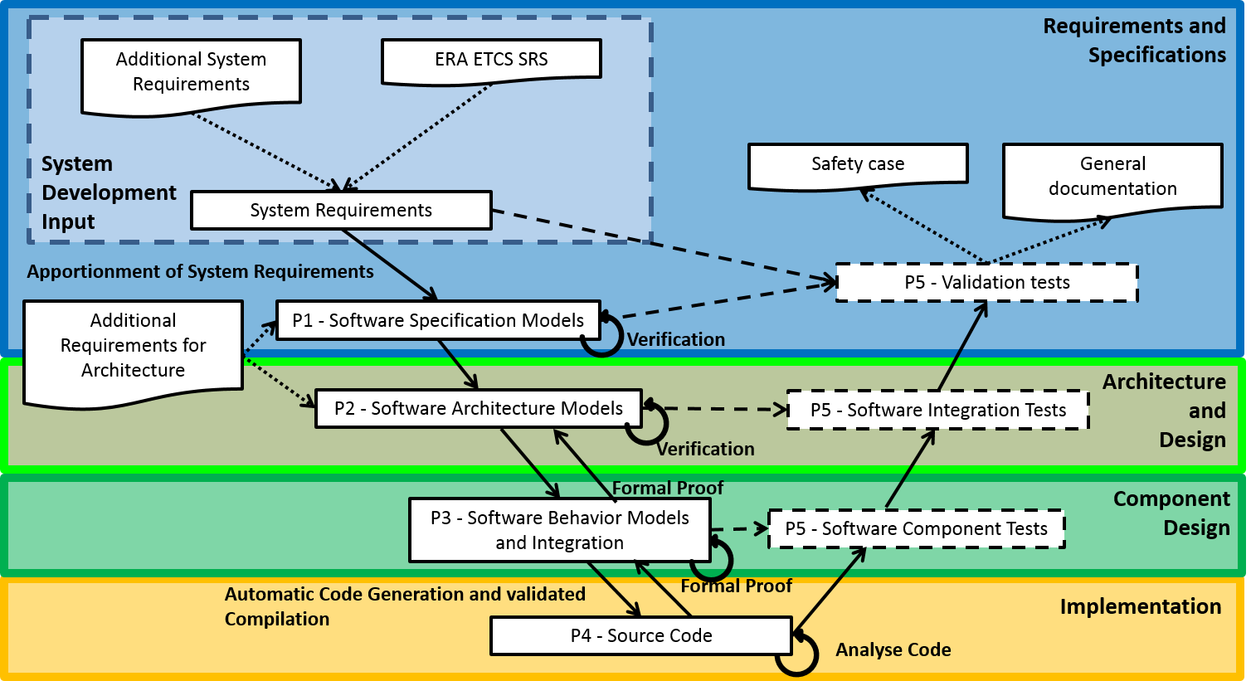

Slide 4
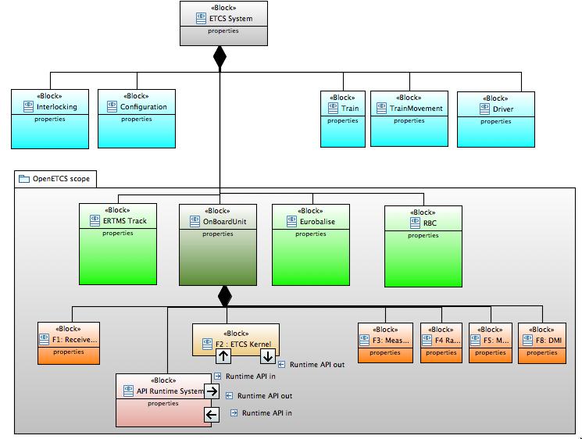

Slide 5
Experience of partners
Input for
ITEA 2 project application documents
ETCS track side equipment
National and Operational rules of operators
Cenelec EN~50126-1:1999 and EN~50128:2011
UNISIG specifications
Utrecht- Amsterdam track
SRS – Subset 26
refinement
User stories
User stories model
Scope
OpenETCS architecture SysML model
Validation scenario
OpenETCS (formal) executable SCADE
Model
Reflect architecture
Integration model
Functional block
integration
Architecture and Design Document
(Draft)
produces
Detailed design function model
Types model
openETCS API
Runtime API interface
Generates (KCG)
SW Runtime System
SW application executable code
Runtime API interface

Slide 6
Experience of partners
UNISIG specifications
ITEA 2 project application documents
ETCS track side equipment
National and Operational rules of operators
Cenelec EN~50126-1:1999 and EN~50128:2011
Utrecht- Amsterdam reference track
SRS – Subset 26
refinement
Provides scope
User stories model
User stories
Baseline of requirements
OpenETCS stakeholder
Reference requirements
OpenETCS product definition
OpenETCS System requirements
(including safety requirements)
OpenETCS Software
Requirements
openETCS API
Import reference requirements
Trace

Slide 7
Experience of partners
UNISIG specifications
ITEA 2 project application documents
ETCS track side equipment
National and Operational rules of operators
Cenelec EN~50126-1:1999 and EN~50128:2011
Utrecht- Amsterdam reference track
SRS – Subset 26
refinement
User stories model
User stories
OpenETCS requirements
baseline
OpenETCS product definition
SRS Subset 26 requirements
as .ReqIF files matching chapters
Translation
D2.6.9
Translation
Additional openETCS requirements as .reqIF files
openETCS API
Provides reference requirements
Document format
Database format

Slide 8
OpenETCS traceability priority
Traceability links to define and maintain (in current design process)
Traceability links automatically defined and maintained by generation
SRS – Subset 26
System architecture
(System + Subsystem + SW functions) SysML model
openETCS OBU formal executable (SW architecture + SW functions + detailed design) SCADE model
User stories
openETCS derived and decomposed requirements
OpenETCS API
Generated SW code

Slide 9
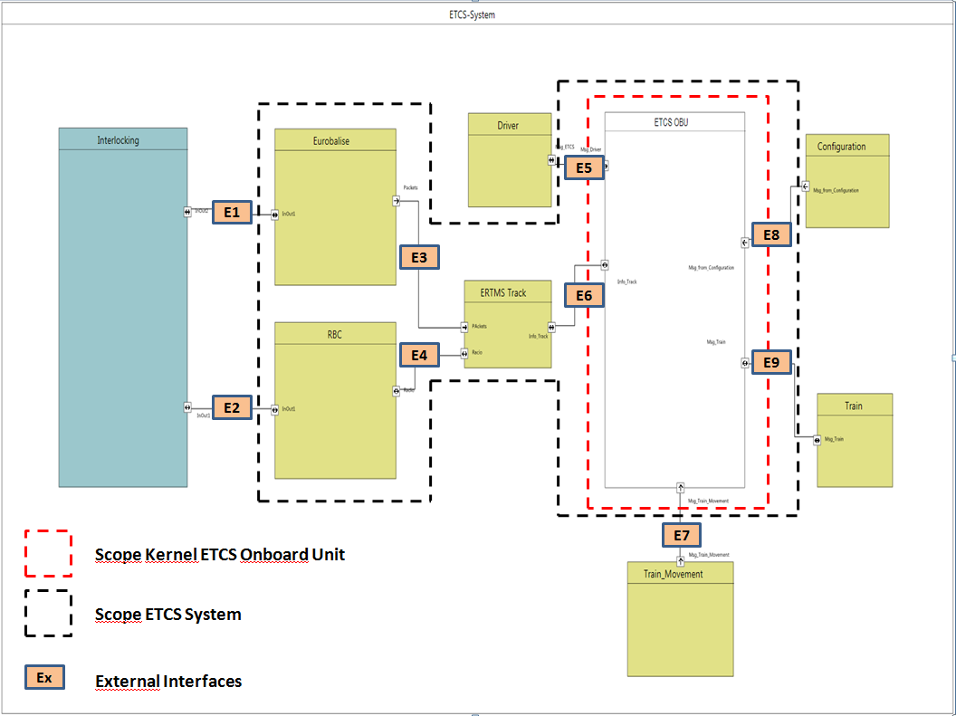
requirement creation at system level
OpenETCS product definition
SRS Subset 26 requirements
as .ReqIF files
OpenETCS architecture SysML model - system level definition
External System Interfaces
Additional openETCS requirements
System IF Req 1
External SW Interfaces
SW Req 1
SW
Req 2
Deduce (create) requirements
Requirement analysis

Slide 10
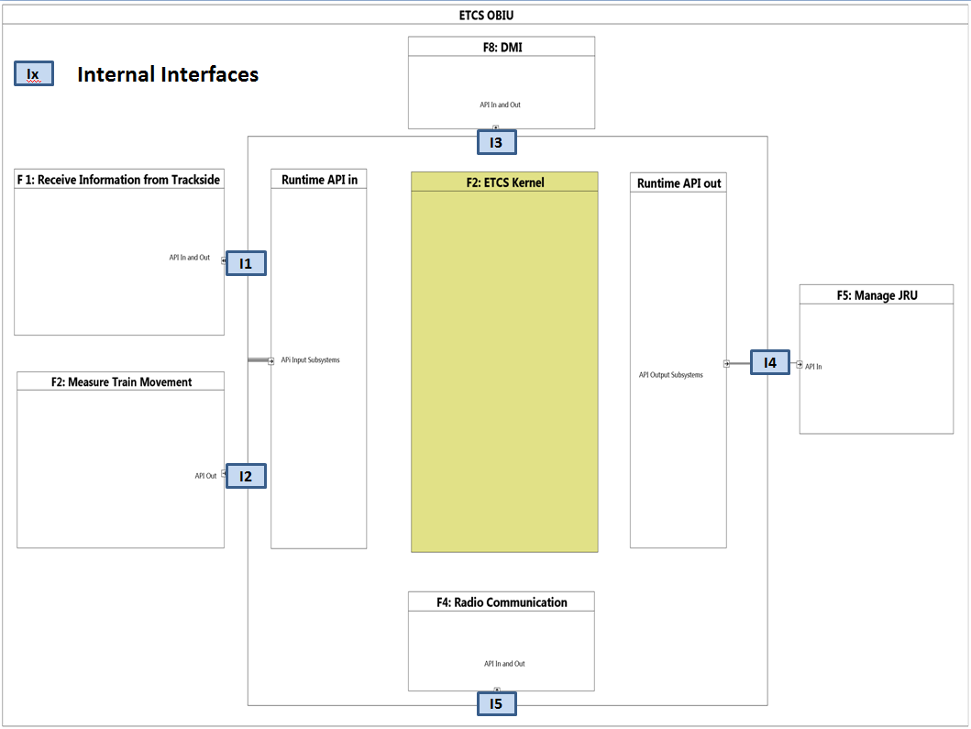
requirement creation at software level
SRS Subset 26 requirements
as .ReqIF files
OpenETCS architecture SysML model for system and SW architecture definition
OpenETCS Software
Requirements
Software level
requirements
OpenETCS (formal) overall executable SCADE Model
Reflect architecture
SW Component
Requirements
SW Integration model
SW Component
Interface requirements
Deduce (create) requirements
Input for

Slide 11
requirement creation at software level
OpenETCS product definition
OpenETCS architecture SysML model - system level definition
Deduce (create) requirements
SRS Subset 26 requirements
as .ReqIF files
Input
OpenETCS Software
Requirements
OpenETCS (formal) executable SCADE
Model
Software level
requirements
Reflect architecture
OpenETCS SW Architecture and Design Document (Draft)
Integration model
SW Component
Requirements
Functional block definition
integration
Detailed design function model
SW Component
Interface requirements
Types model
openETCS API
Generates (KCG)
SW application executable code

Slide 12
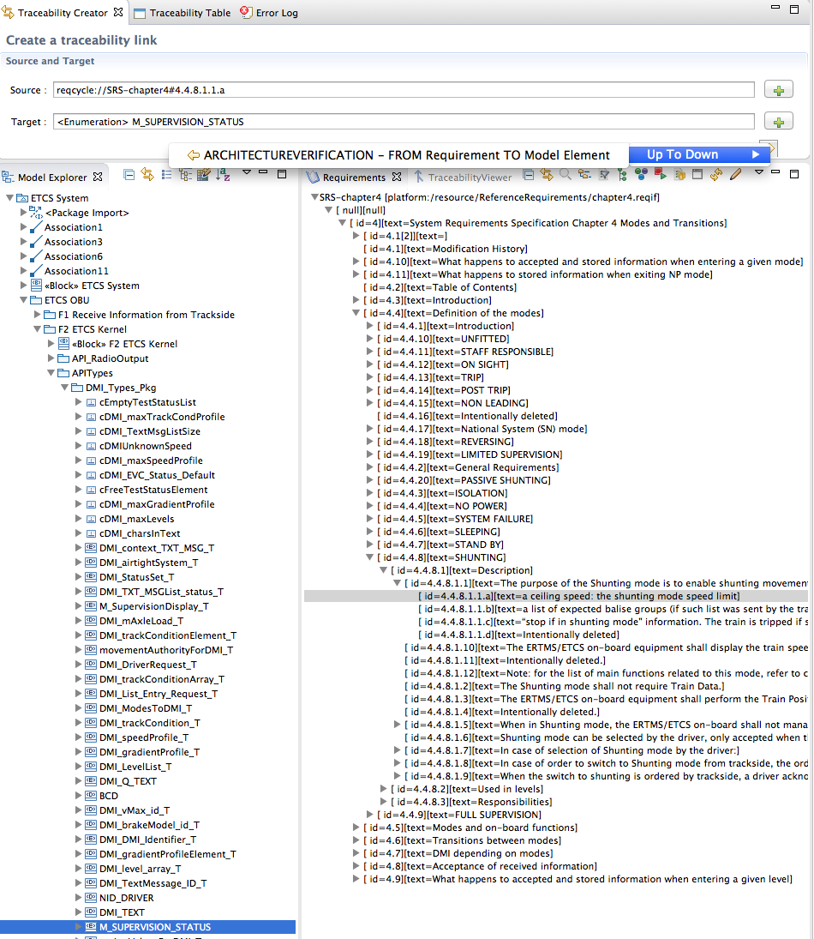

Slide 13
Experience of partners
UNISIG specifications
ITEA 2 project application documents
ETCS track side equipment
National and Operational rules of operators
Cenelec EN~50126-1:1999 and EN~50128:2011
Utrecht- Amsterdam reference track
SRS – Subset 26
refinement
User stories
User stories model
Provides scope
OpenETCS architecture SysML model
Validation scenario
Validated by
OpenETCS (formal) executable SCADE
Model
Reflect architecture
Integration model
Architecture and Design Document
(Draft)
Functional block
integration
Satisfies
produces
Detailed design function model
Types model
implements
openETCS API
Runtime API interface
Satisfies
Generates (KCG)
SW Runtime System
SW application executable code
Runtime API interface

Slide 14
Operational environment
model (SCADE)
Architecture
Model (SysML)
OBU integration Executable formal
Model (SCADE)
F2.1
F2.2
F2.3
F2.15
Functional design model

Slide 15
WP3 priorities regarding traceability
Urgent: Scade model to SRS traceability
Either through ReqTify tool
Else (ideally) through open source solution
Nice to have: SysML model to SRS traeability
Either through ReqIF/ReqCycle
Else through other open source chain

Slide 16





Current solution – ProR + ReqCycle
Import (script)
classify
Subset 026
Reference Requirement Data Base
ProR
Copy
/ update
copy
store
ReqCycle
RM Gateway (based on ReqTify)
Read Only Requirement Data Base
Link
Link
Export traces
Export
traces
Papyrus
SCADE
Create tests
RT-tester
GenDoc

Slide 17
2nd solution – ProR + ReqCycle
Import
Subset 026
ProR
Reference Requirement Data Base
OpenETCS API
Import
ReqCycle
Read Only Requirement Data Base
Link
Link
Export
Papyrus
SCADE
Create tests
RT-tester
GenDoc

Slide 18
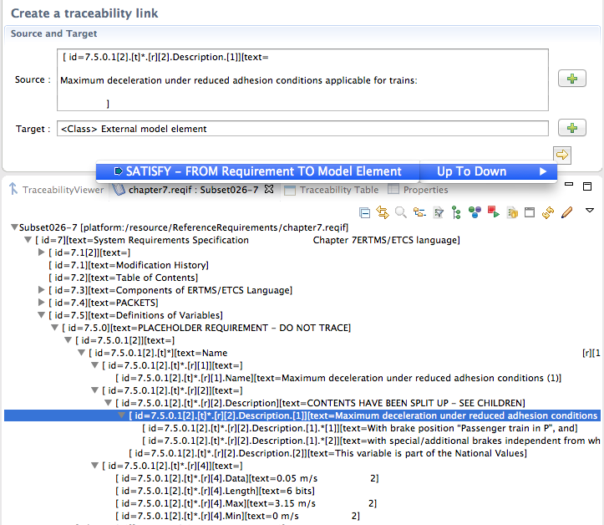

Reqcycle – prepare trace link with SCADE
Generate requirement traceability annotation for external element
Copies traceability string annotation (ReqID + Satisfy ID) to clipboard

Slide 19
3rd solution – ReqCycle only
Subset 026
1.B1 Import
Subset 026 requirements
1.A Import
1.B2 Import
OpenETCS API
Import
ReqCycle
Update
Reference Requirement Data Base
Link
Link
Papyrus
SCADE
export
RT-tester
GenDoc

Slide 20



OpenETCS current tooling context
Derive
Current traceability
User stories
User stories model
In sequence diagram
Cenelec EN50128
System requirements
OpenETCS architecture SysML model
SRS – Subset 26
OpenETCS function Scade model
Architecture and Design Document
Draft
System level requirements
Decomposed and derived requirements
Data dictionnary model
reqID in comments area
Partially done
Req gateway
code generator
C code

Slide 21
BACKUP

Slide 22
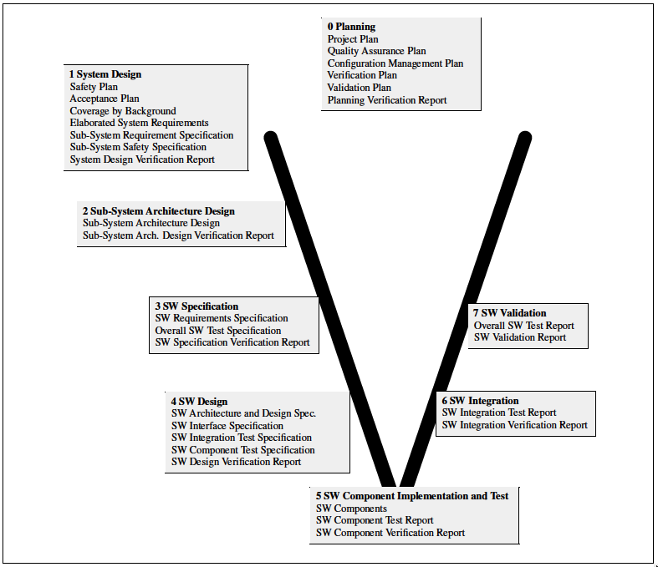

Slide 23
Standard Engineering
requirements
OpenETCS Background
Domain/project
specifications
Needs/requirements defined by project
Plans defined by project
Input for
System and project context: standards, reference and background material
Experience of partners
ETCS track side equipment
UNISIG specifications
National and Operational rules of operators
ITEA 2 project application documents
Cenelec EN~50126-1:1999
System other needs/inputs
System (ETCS)
definition
Plans
Elaborated SRS
(relevant for project)
System architecture design specification
Safety Plan
Hazard & Risks
SS other needs/inputs
subsystem level definition
Acceptance
Plan
Subsystem Safety specification
SubSystem
architecture design specification
Hazard & Risks
Subsystem requirements
QA plan
UNISIG– Subset 26
HW API
Validation plan
SW needs
SW level definition
SW Requirements
(including safety requirements)
Verification
plan
SW Overall Test Specification
Cenelec EN~50128:2011
Software design
(SW components)
SW Integration Test Specification
SW Interface Specification
SW architecture design specification
OpenETCS API

Slide 24
3 generic Systems engineering levels
Transformed into
Stakeholders Needs
Stakeholders
requirements
Trace
System-of-interest problem definition
System-of-interest (SoI) requirements
Other needs for SoI
System-of-interest
Solution definition
(system and subsystems recursive definition)
Subsystem 1
Stakeholder
requirements
System leaf Element stakeholder requirements
Subsystem 2
Stakeholder requirements
Subsystem 2
requirements
Other needs for Subsystem 2
Subsystem 2 leaf element stakeholder requirements
Subsystem 2.1
requirements
Subsystem 2.2 requirements
To be continued (recursive)
To be continued (recursive)
System leaf element can be software, hardware, data or procedure
System-of-interest leaf element definition
(lowest definition level)
Element requirements
Element
requirements
Other needs for elements

Slide 25
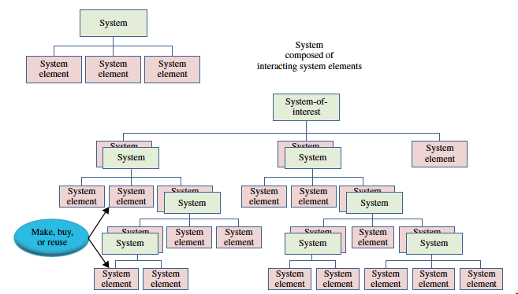

Slide 26
Standard SE process with models
derive
Traceability (between requirements or through models)
Stakeholders Needs
System needs model
UC / User Stories / Operational Scenarios
Operational modes
Stakeholders
requirements
System boundaries model
System main functions
Interface definitions
System requirements
System level requirements
System Architecture Model
Functional/logical architecture
Physical configuration items
Constraints/Equations
Allocations
Decomposed and derived requirements
SW building block Requirements
SW Architecture Model
Architecture / Design
SW low-level requirements
SW Code

Slide 27
OpenETCS current process vs. standard
derive
Direct traceability
Indirect traceability
through models
User stories
Stakeholders Needs
System needs model
UC / User Stories / Operational Scenarios
Operational modes
User stories model
Cenelec EN50128
Stakeholders
requirements
System boundaries model
System main functions
Interface definitions
OpenETCS architecture (semi formal) model
System requirements
SRS – Subset 26
OpenETCS function
(formal) model
System level requirements
Data dictionnary model
System Architecture Model
Functional/logical architecture
Physical configuration items
Constraints/Equations
Allocations
Decomposed and derived requirements
Architecture and Design Document
Draft
reqID in comments area
SW building block Requirements
SW Architecture Model
Architecture / Design
code generator
SW low-level requirements
SW Code

Slide 28
Experience of partners
UNISIG specifications
ITEA 2 project application documents
ETCS track side equipment
National and Operational rules of operators
Cenelec EN~50126-1:1999 and EN~50128:2011
Utrecht- Amsterdam reference track
SRS – Subset 26
refinement
Provides scope
User stories model
User stories
OpenETCS product definition
OpenETCS stakeholder
reference (baselined) requirements
OpenETCS System Requirements
System level
Subsystem level
OpenETCS Software
Requirements
Software level
Trace
openETCS API
Provides reference requirements
Component level

Slide 29
Summary of requirement creation
OpenETCS product definition
OpenETCS architecture SysML model - system level definition
OpenETCS stakeholder
reference (baselined) requirements
OpenETCS System
Requirements
System level
Subsystem level
OpenETCS Software
Requirements
Software level
Deduce (create) requirements
Requirement analysis

Slide 30
requirement creation at system level
OpenETCS product definition
Deduce (create) requirements
OpenETCS architecture SysML model - system level definition
OpenETCS System requirements
External IF
System level
External IF
Subsystem level

Slide 31
Experience of partners
UNISIG specifications
ITEA 2 project application documents
ETCS track side equipment
National and Operational rules of operators
Cenelec EN~50126-1:1999 and EN~50128:2011
Utrecht- Amsterdam reference track
SRS – Subset 26
refinement
Provides scope
User stories model
User stories
OpenETCS product definition
OpenETCS stakeholder
reference (baselined) requirements
openETCS API
Deduce (create) requirements

Slide 32
OpenETCS traceability priority
Traceability links to define and maintain in “full process”
Traceability links automatically defined and maintained by generation
SRS – Subset 26
User stories
openETCS OBU formal executable (SW architecture + SW functions + detailed design) SCADE model
System architecture
(system + SW) SysML model
openETCS derived and decomposed requirements
OpenETCS API
Generated SW code

Slide 33
requirement creation at system level
OpenETCS stakeholder
reference (baselined) requirements
OpenETCS product definition
OpenETCS architecture SysML model - system level definition
OpenETCS System requirements
External System Interfaces
External SW Interfaces
OpenETCS Software
Requirements
Deduce (create) requirements
Requirement analysis
Trace

Slide 34
requirement creation at system level
OpenETCS product definition
SRS Subset 26 requirements
as .ReqIF files
OpenETCS architecture SysML model - system level definition
External System Interfaces
Additional openETCS requirements
System IF Req 1
External SW Interfaces
SW IF Req 1
SW IF
Req 2
Deduce (create) requirements
Requirement analysis

Slide 35
requirement creation at software level
OpenETCS product definition
OpenETCS architecture SysML model - system level definition
Deduce (create) requirements
OpenETCS Software
Requirements
System functions and Internal IF
Reflect architecture
OpenETCS (formal) executable SCADE
Model
Software level
Integration model
OpenETCS SW Architecture and Design Document (Draft)
Functional block
integration
Detailed design function model
Component
level
Types model
Generates (KCG)
SW application executable code

Slide 36
Summary of requirement creation
OpenETCS product definition
OpenETCS architecture SysML model - system level definition
Deduce (create) requirements
OpenETCS System
Requirements
System level
OpenETCS (formal) executable SCADE
Model
Subsystem level
Reflect architecture
OpenETCS Software
Requirements
Integration model
Functional block
OpenETCS SW Architecture and Design Document (Draft)
Software level
integration
Detailed design function model
Component
level
Types model
Generates (KCG)
SW application executable code

